Slide 1
DSP Labs
Engr Kaleem Ullah
kalim.ullah@seecs.edu.pk

Slide 2
Tentative Lab Experiment List:
Lab 01: | MATLAB REVIEW-Signals & Systems Fundamentals
Lab 02: | Complex Exponentials and Sinusoids
Lab 03: | A/D and D/A Conversion : Digital Images
Lab04: | Sampling, Quantization and Aliasing of audio signal in Matlab
Lab05: | FFT and spectrum leakage
Lab 06: | Frequency Response and Pole Zero Plots of FIR/IIR Filters
Lab 07: | Frequency Response, Bandpass And Nulling Filters
Lab 08: | FIR Filter Design Using Windowing –Open Ended Lab
Lab 09: | IIR Filter Design using Analog Design Techniques
Lab 10: | Introduction to DSP KIT TMS 320C6713 DSK
Lab 11: | Audio Processing using DSP Kit TMS 320C6713 DSK
Lab 12: | Delays And FIR Filtering (DSK)

Slide 3
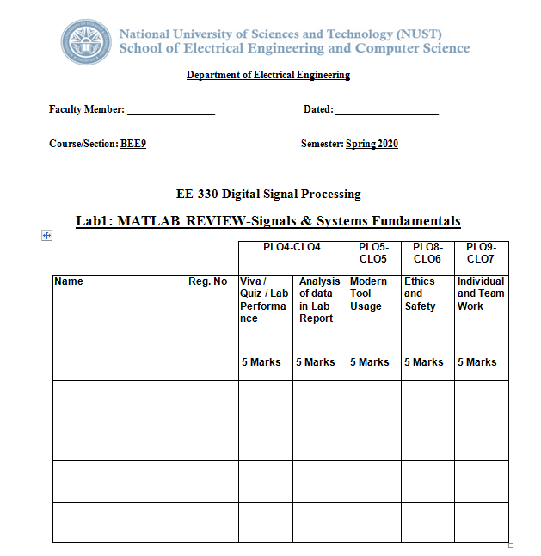
Lab Grading and Assesment

Slide 4
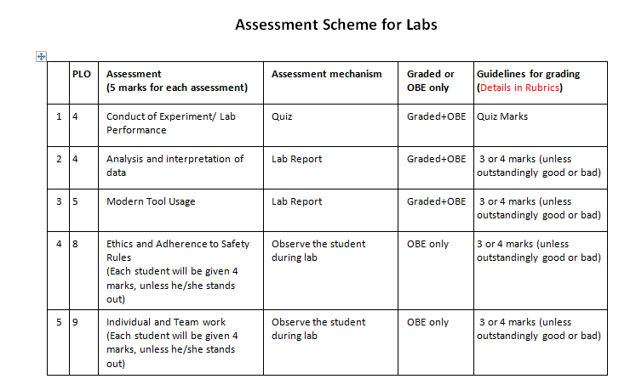

Slide 5
Lab Instructions
The students should perform and demonstrate each lab task separately for step-wise evaluation.
Each student shall submit one lab report on LMS within 5 days after lab is conducted. Extra 24 hours will be given for late submission with 20% deduction.
Lab report submitted via email will not be graded.
Students are however encouraged to practice on their own in spare time for enhancing their skills.
Lab Report Instructions
All questions should be answered precisely to get maximum credit. Lab report must ensure following items:
Lab objectives
MATLAB codes/C codes
Results (graphs/tables) duly commented and discussed
Conclusion

